Slide 1
TYPES OF LAMPS
POWERPOINT PRESENTATION BY:-
POONAM SHARMA
LECTURER ELECTRICAL
G.O

Slide 9
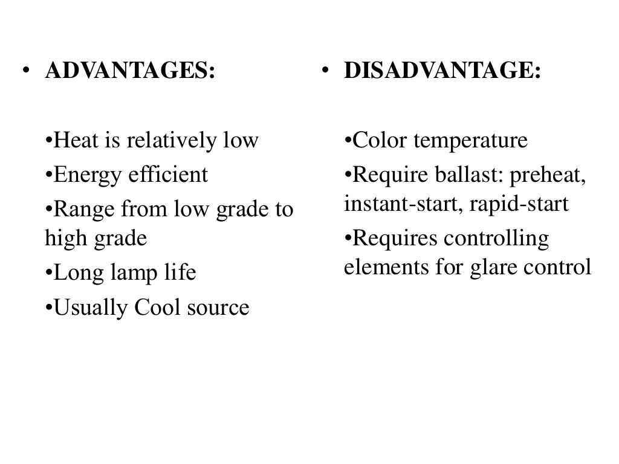

Slide 14
THANK YOU

